Slide 1
The Kingdom’s Bank Project
Invitation to Stakeholders

Slide 2
Can you Imagine…
Making focused efforts, united?
Having a shared vision?
Receiving Reports on your progress?
Belonging to an altruistic project that benefits all humankind?
Knowing that your efforts are never too small?
God’s will manifested on earth? Preach The Good News to All Nations? To heal the sick and feed the hungry?
The path to ending sickness, hunger, poverty, and despair?
An amazing future where you and your children are thriving in a safe, faith-filled environment?
Living an abundant, fulfilling life? For you and for others?

Slide 3
From The Lord, To The Lord
The Kingdom’s Bank Project will expand God’s Kingdom and do His Will by:
Preaching The Gospel (God’s good news) to all Nations
Feeding the Poor
Caring for Orphans, Widows and the Brokenhearted
Healing the Sick
Making Disciples
Building the Cluster in the Community
My Brother’s Keeper

Slide 4
The Kingdom’s Mission and Vision
Preaching The Gospel
Feeding the Poor
Healing the Sick
Gospel Kits and Certificates of Attendance
Salvation
Baptism
Mind Renewal
Recruit/Build Churches
Recruit/Build Faith-based Schools
Feeding Centers
Food Outreach food delivery
Agriculture and Vertical Farming
Partnering with Shelters and Kitchens
Partnering with Food Prepping Services
Drug assistance
Community Health Centers
Healed by His Stripes Seminar
Insurance Premium Assistance
Cure Research Funding
“I have come that they may have life, and that they may have it more abundantly.” John 10:10

Slide 5
The Kingdom’s Mission and Vision
Caring for Orphans, Widows and the Brokenhearted
Making Disciples
Building the Cluster in the Community
Temporary housing
Spiritual and Total Support
Accessibility & Connection to The Kingdom
Loans and grants
Career Coaching
Extensive Library Access
End Illiteracy Workshops
K-12 Let the Children Bilingual Schools
Rebirth Centers
Sunday Church Service
The Kingdom’s News©.
International Branches/Clusters
Not for Profit Bank Branches
Build/Recruit Schools
Build/Recruit Amphitheaters
Secure Kingdom’s Com App
HIP (Happy Imperfect People) Centers
Housing & Transportation
“I have come that they may have life, and that they may have it more abundantly.” John 10:10

Slide 6
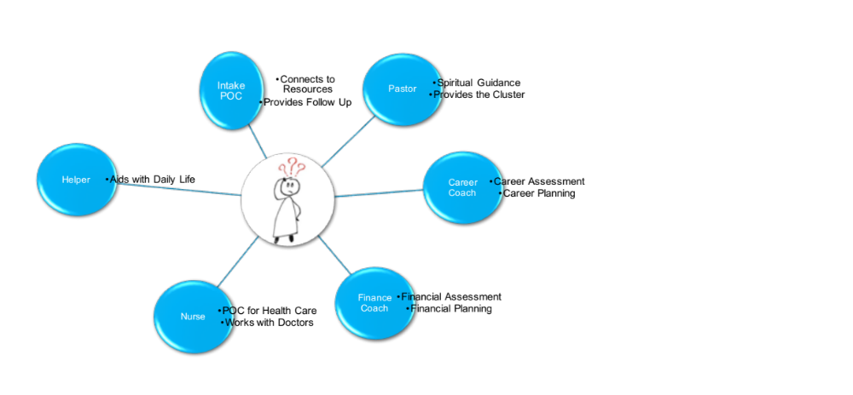
Empowering the Righteous
*Many more Labor Categories are available depending on needs
“Inasmuch as ye have done it unto one of the least of these my brethren, ye have done it unto me” Mat. 25:40

Slide 7
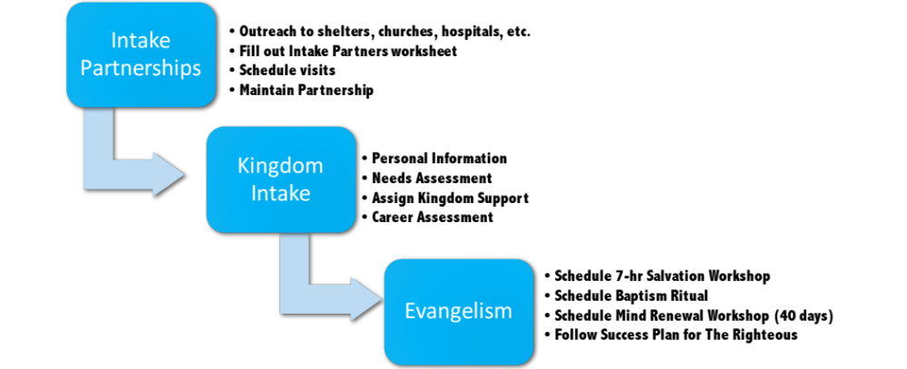
Building Partnerships to Ensure The Kingdom Reaches the Needy

Slide 8
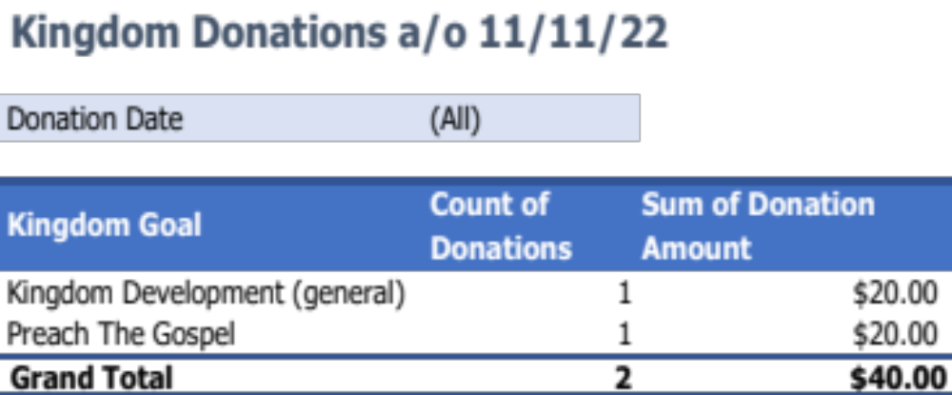
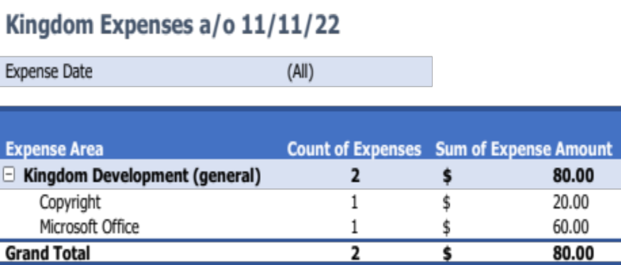
Kingdom Transaction Reports by Goal
If you prayed about it and can’t wait to get started, you can send your tithe or offering to The Kingdom’s Treasury through Zelle to 703-309-4467 and state, in the transaction notes, your preferences of which Mission area you want to invest in The Kingdom!
The following slide lists Kingdom needs for your consideration.

Slide 9
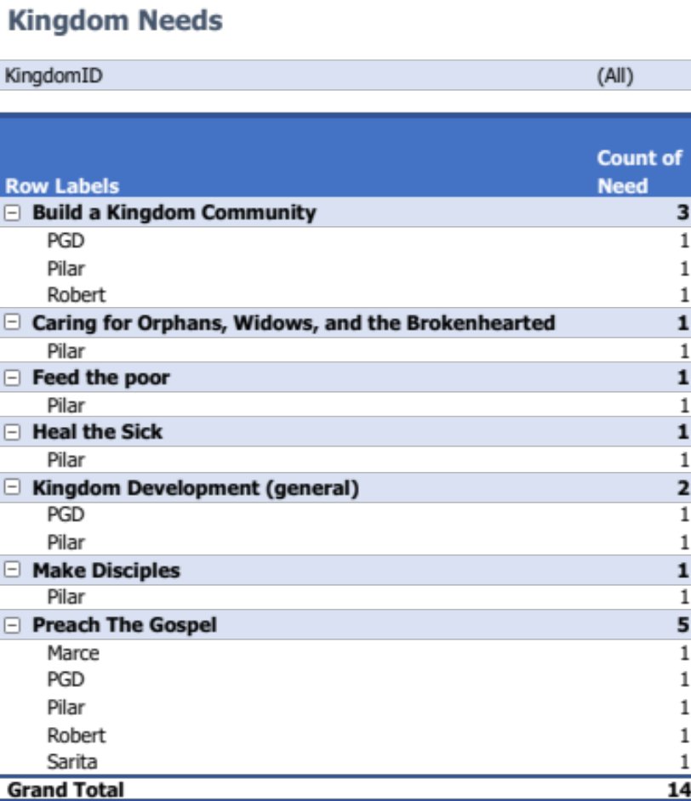
Current Kingdom Needs a/o 11/11/22
“Give, and it will be given to you: good measure, pressed down, shaken together, and running over will be put into your bosom. For with the same measure that you use, it will be measured back to you.” John 6:38
“Here mortal men receive tithes, but there He receives them, of whom it is witnessed that He lives” Hebrews 7:8
“So let each one give as he purposes in his heart, not grudgingly or of necessity; for God loves a cheerful giver.” 2 Corinthians 9:7
Zelle money to 703-309-4467 and WhatsApp ideas/questions/volunteer to 703-309-4467

Slide 10
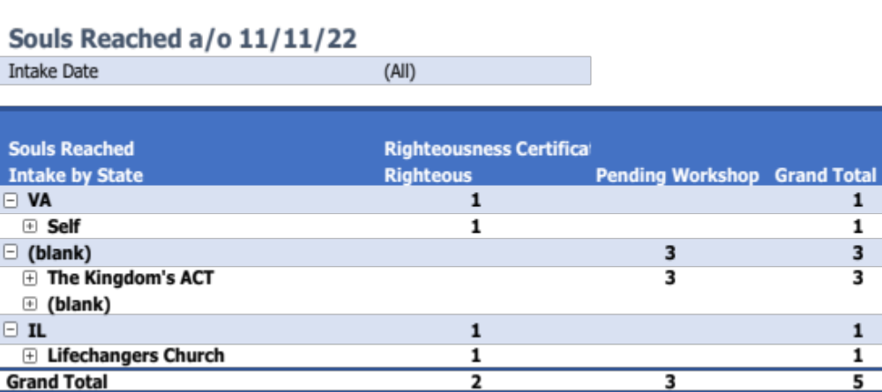
Now is the time to ACT!
View this presentation
Read the Invitation to Stakeholders booklet TKB.pdf
Forward these documents to all the people you know who have a heart for God. Let’s make it go viral
Imagine your part in the project
Imagine your impact in the project
You don’t need to change your religion, just hear the message of Salvation and your life will be changed!
If you’re filled with excitement and want to be part of this ambitious effort, text Intake through WhatsApp to 703-309-4467, and a Kingdom Intake POC will contact you shortly to interview you and assess your needs and talents!
Welcome To The Kingdom’s Acts!

Slide 11
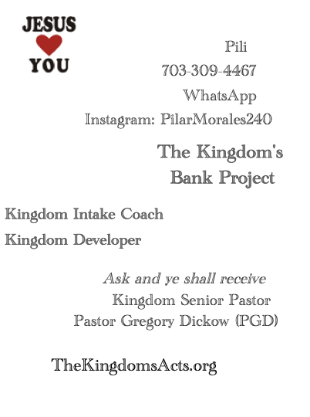
Read the PDF with Detailed Information
To receive The Kingdom’s Bank Project, Invitation to Stakeholders, and any future editions or updates, send a text through WhatsApp to 703-309-4467 with the word Subscribe. You will receive the file TKB.pdf
Soon, you’ll be able to visit our webpage and download the files!
Read The Gospel Points File!
Have a spare hour per week or per month to check on someone who is isolated or lonely? Become a Kingdom Friend!
“Instead, use your hands for good hard work, and then give generously to others in need.” Ephesians 4:28

Slide 12
Thank you and welcome to The Kingdom’s Bank Project!
Maria Del Pilar Morales, “Pili”
From The Lord, To The Lord

